Slide 1
Power BI Security Best Practices
Ted Pattison
Instructor and Power BI MVP

Slide 2
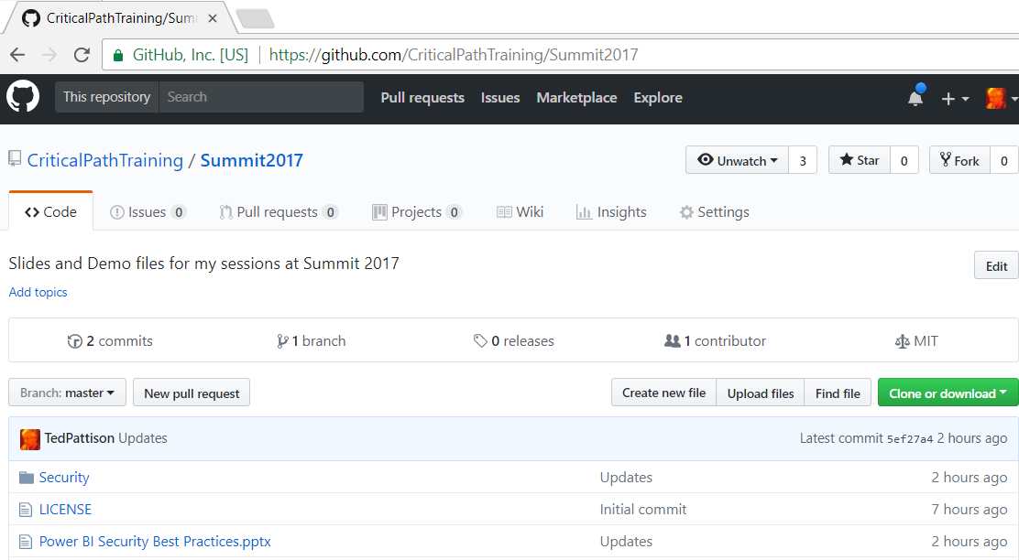
Slides and Demo Files for this Session
https://github.com/CriticalPathTraining/Summit2017

Slide 3
Agenda
User Authentication and Identity
Power BI Tenant Administration
Data Security
App Workspaces
Row Level Security
Dynamic Row Level Security

Slide 4
Power BI Built on Azure Active Directory
Azure AD manages identity in Microsoft cloud
Organization creates user accounts & groups in Azure AD
Users accounts and groups created in scope of tenant
Azure AD provides user authentication service
Azure AD manages licensing and permissions
Provides users authorized access to Office 365
Provides users authorized access to SharePoint Online
Provides users authorized access to Dynamics 365
Provides users authorized access to Power BI

Slide 5
Managing User Accounts and Groups
Microsoft SaaS Applications
Office 365
Dynamics 365
SharePoint Online
Power BI
Azure User Account Management
Office 365 Admin
Azure Portal
In Tune
Azure Active Directory
Organizational Tenant (e.g. cpt0926.onMicrosoft.com)
User Accounts
Groups
Applications

Slide 6
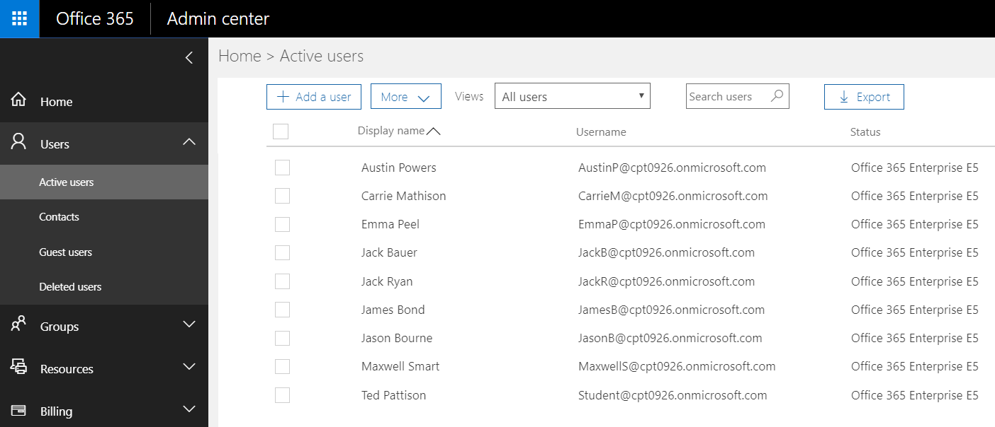
Azure AD User Accounts and Licensing
User account created within scope of tenant
Office 365 admin create accounts and assigns licenses

Slide 7
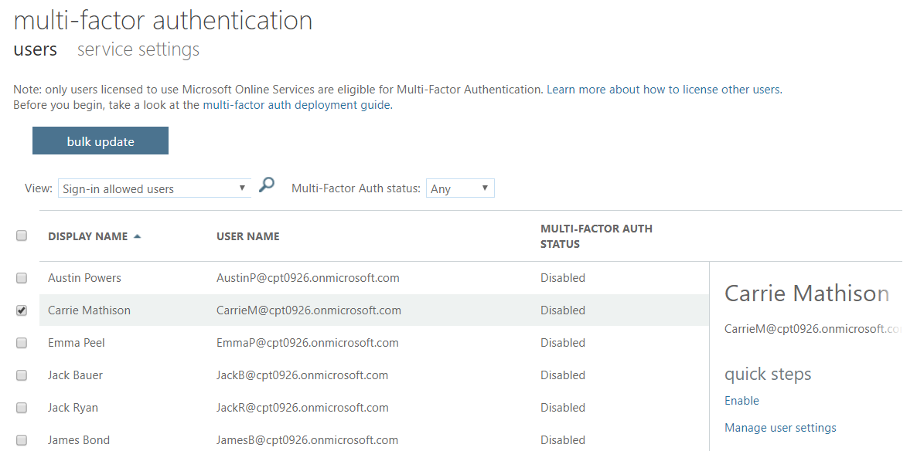
Multifactor Authentication
Enabled through admin portal
Requires Office 365 or Azure AD Premium

Slide 8
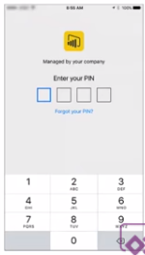
User Access Control for Mobile Devices
Mobile Device Power BI App Management
Controlled via InTune for iPhone (iOS7) and Android
Policy can be configured to make users enter PIN
Account locked after max number of failed PIN logins
Configuring the Power BI app with InTune
Specify the Power BI app as the app to configure
Configure policies (e.g. require PIN)
Enable for deployment
Users install Power BI app from company portal

Slide 9
Conditional Access for Web and Mobile
Azure AD supports configuring conditional access
Control which IP address ranges can connect (Corp LAN)
Control which devices can connect
Configure access so only group members can connect
Configure which users or IP address ranges require 2FA
Lots more is possible

Slide 10
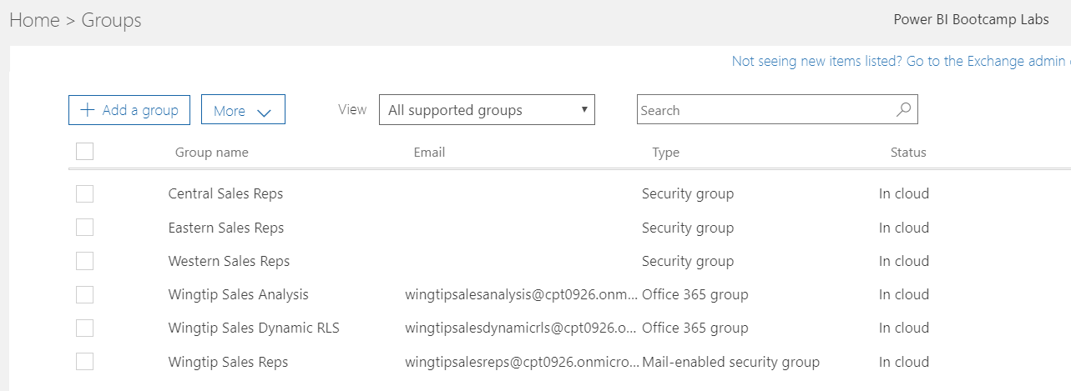
Azure AD Group Types
Azure AD Group Types
Security Groups
Mail-enabled Security Groups
Office 365 Groups

Slide 11
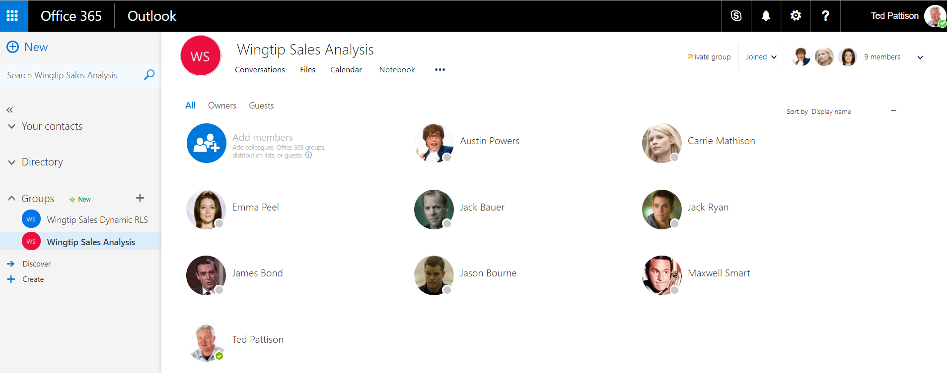
Office 365 Groups

Slide 12
Agenda
User Authentication and Identity
Power BI Tenant Administration
Data Security
App Workspaces
Row Level Security
Dynamic Row Level Security

Slide 13
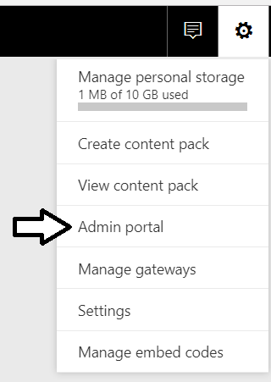
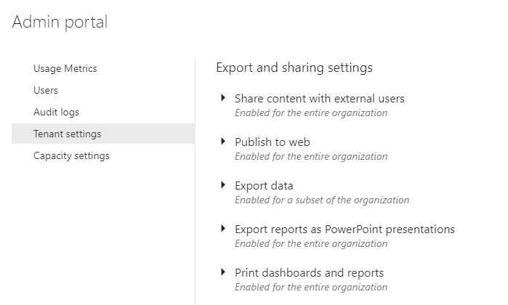
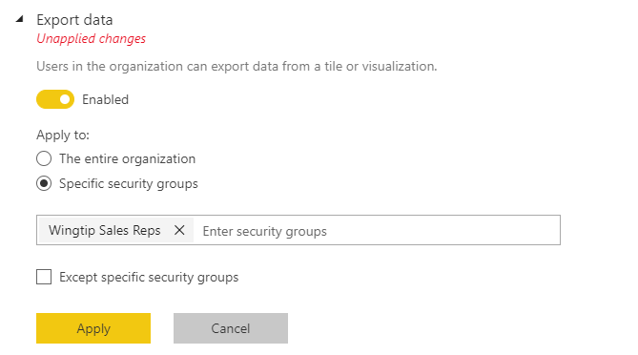
Power BI Admin Portal
Power BI Admins control tenant-level settings
Control whether users can self-register for Power BI
Control who can publish to web
Control who can export & share content
Control who can create content packs

Slide 14
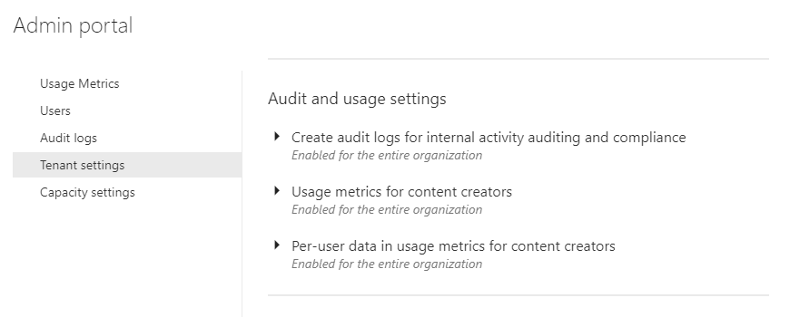
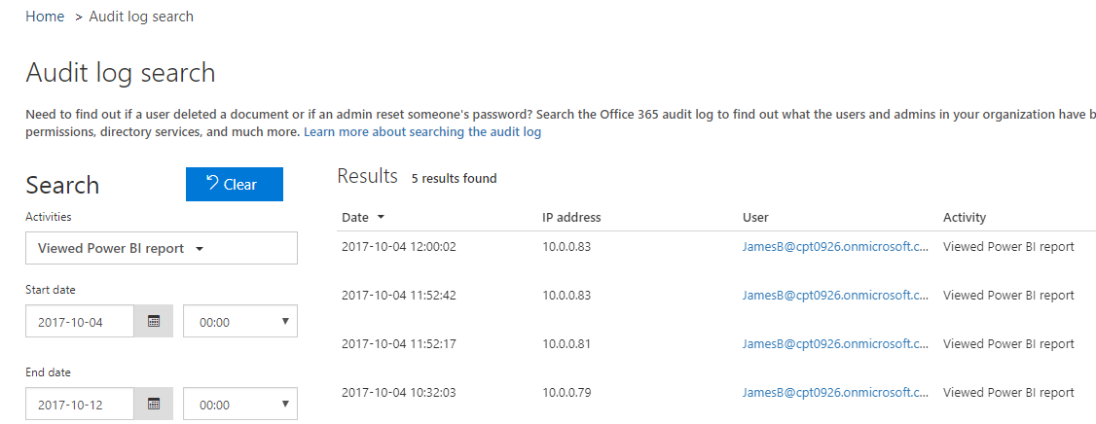
Power BI Audit Log

Slide 15
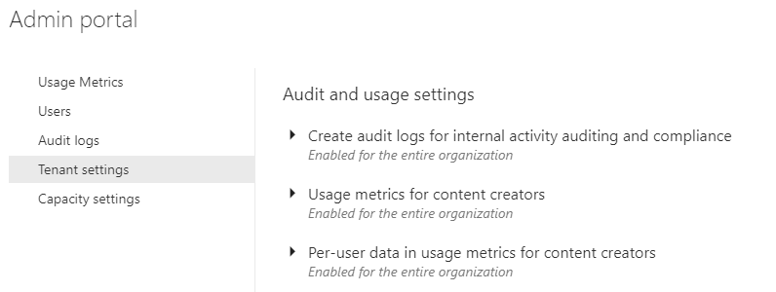
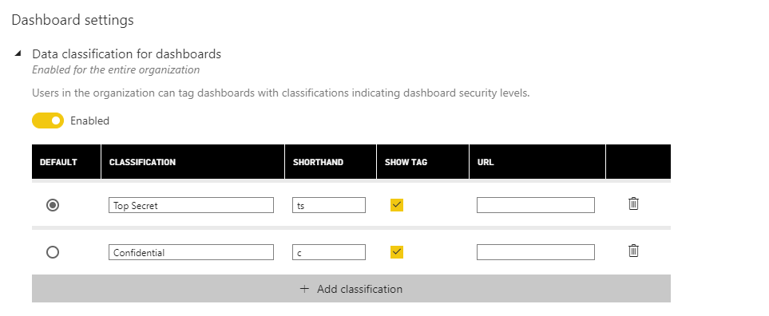
Data Classification for Dashboards

Slide 16
Agenda
User Authentication and Identity
Power BI Tenant Administration
Data Security
App Workspaces
Row Level Security
Dynamic Row Level Security

Slide 17
Types of Data
Imported Data (aka ETL Data)
Data cached in Power BI and refreshed using saved credentials
Live Connection or Direct Query
Data pulled into Power BI at query time using saved credentials
Pushed Data
Data pushed into Power BI by external application
Cloud-based Datasource
Azure AD
Azure SQL
On-Premises Datasources
Local AD
SQL Server

Slide 18
Data Is Always in One of Three States
Data can be In Transit
Moving between data source, Power BI and client
Data is always encrypted using HTTPS or Azure Service Bus
Data can be In Process
Data loaded into cloud-based memory
Data can be At Rest
Data stored in cloud-based storage
Data encrypted using internally managed encryption keys

Slide 19
Storage of Data At Rest
What types of data must be stored at rest?
Data (i.e. Dataset)
Credentials
Metadata for report and dashboard layouts
Data source | Data | Metadata | Credentials
Imported Data | Azure Blob Storage | Azure Blob Storage | Azure SQL
Direct Query | Nothing | Azure Blob Storage | Azure SQL
Live Connection | Nothing | Azure Blob Storage | Azure SQL
Push Dataset | Azure SQL | Azure Blob Storage | N/A

Slide 20
Data Encryption
Power BI uses encryption keys for blob storage
Keys stored in separate location from Power BI service
Fully managed by internal Microsoft service
Azure SQL manages encryption internally
Power BI relies on Azure SQL TDE Technology
Used to encrypt credentials to cloud-based sources
For credentials to access on-premises sources
Encryption key created in on-premises data gateway
Encryption key used to encrypt creds stored in cloud

Slide 21
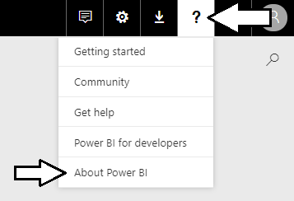
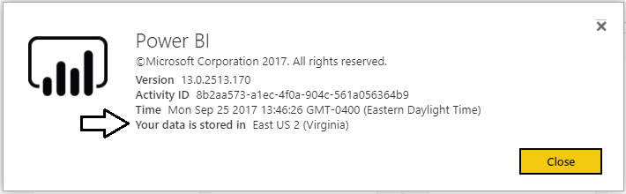
Data Storage Location
Data storage location can be important
Especially with European rules and regulations
Organization has tenant in specific data center

Slide 22
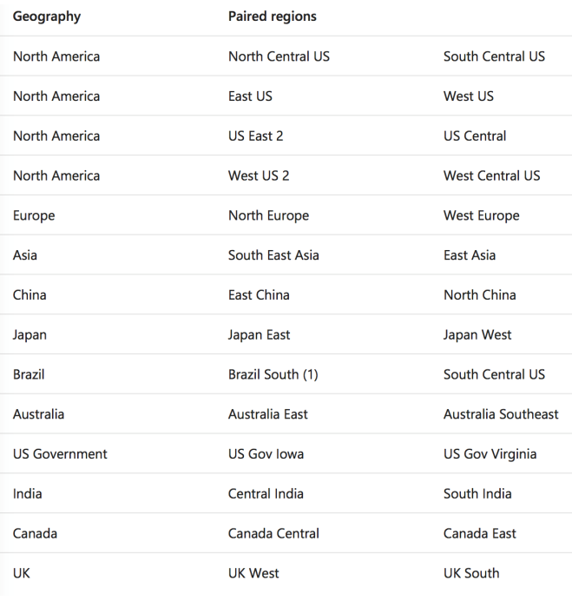
Data Residency and Azure Region Pairs
Data stored in specific Azure Region
Azure region defined data residency
Within a region, data centers are paired

Slide 23
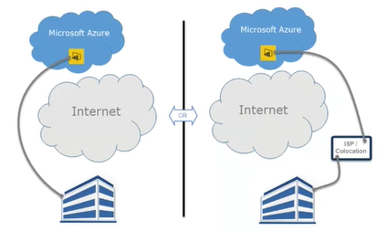
Connecting Through Express Route
Allows you to create private network connection
Connect to Power BI without going through public Internet
Can also connect through ISP’s colocation facility
Azure Express route with Power BI uses public peering

Slide 24
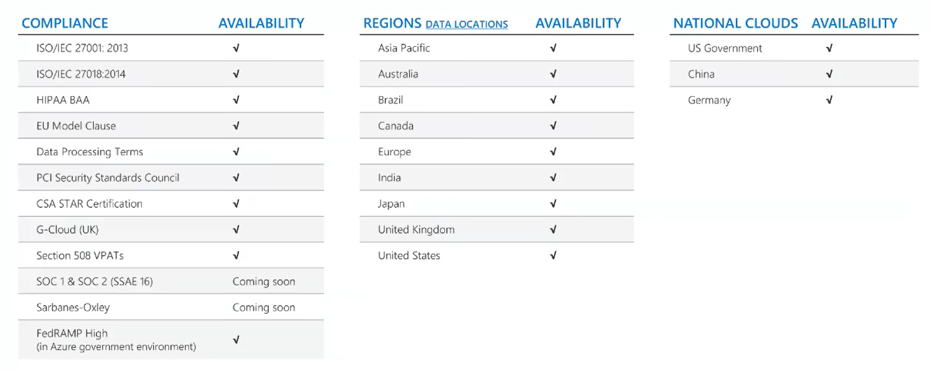
Compliance and Market Availability

Slide 25
Agenda
User Authentication and Identity
Power BI Tenant Administration
Data Security
App Workspaces
Row Level Security
Dynamic Row Level Security

Slide 26
What Exactly is an App Workspace?
App Workspace is Power BI resource container
Provides storage for datasets, reports and dashboards
App Workspace created as Office 365 Group
Acts as both a security group and distribution list
Requires provisioning SharePoint team site
On the Power BI Roadmap
Creating workspace without SharePoint provisioning

Slide 27
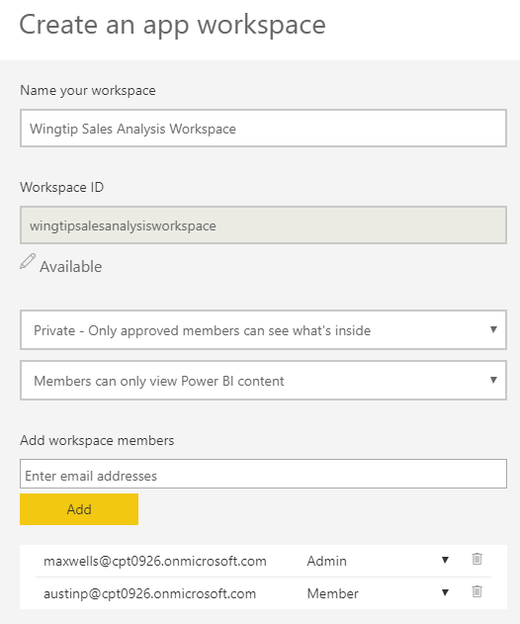
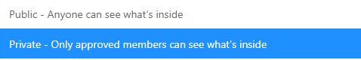

Creating an App Workspace

Slide 28
Old Distribution Model
Dev Workspace
read/write
Production Workspace
Read-only
Dashboards
Dashboards
Reports
Reports
Organizational Content Pack
Datasets
Datasets

Slide 29
New Distribution Model
App Workspace
read/write
Installed App
Read-only
Dashboards
Dashboards
Reports
Reports
Published App
Datasets
Datasets

Slide 30
Agenda
User Authentication and Identity
Power BI Tenant Administration
Data Security
App Workspaces
Row Level Security
Dynamic Row Level Security

Slide 31
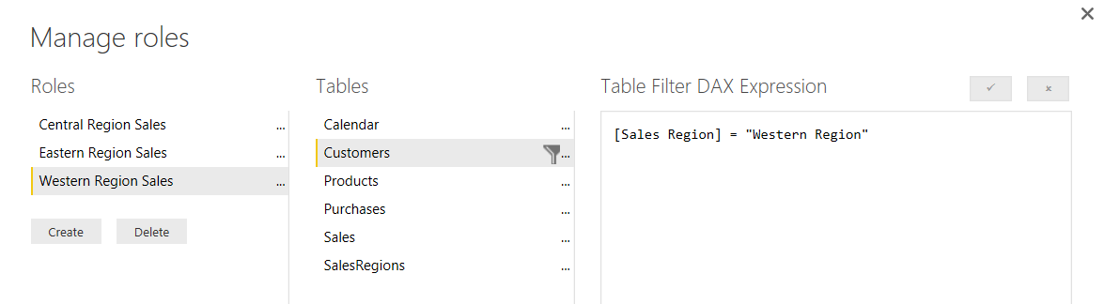
What Is Row-level Security (RLS)
Security Scheme based on Named Roles
Roles are defined using Power BI Desktop
Each role is scoped to the dataset within a PBIX project
Role defined using one or more DAX expressions
DAX expressions restrict which rows are accessible

Slide 32
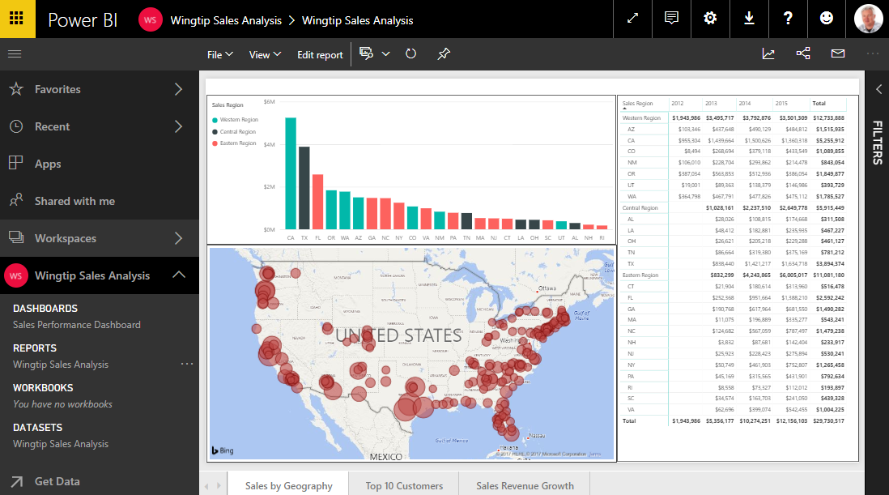
Common RLS Scenario

Slide 33
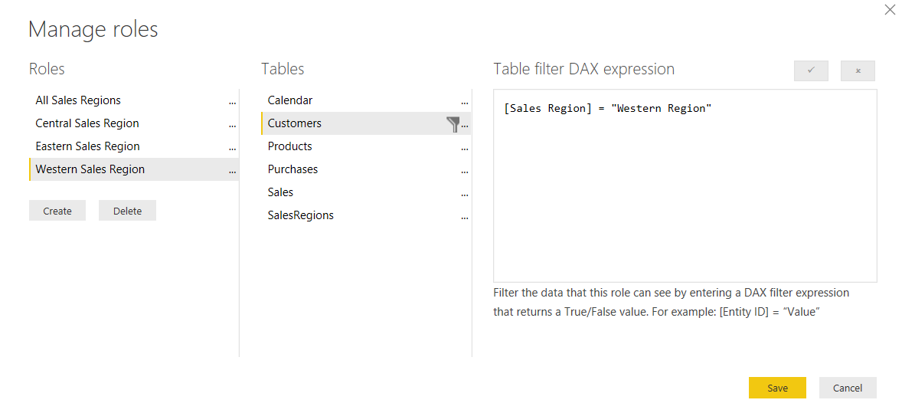
Configuring RLS in the Power BI Desktop

Slide 34
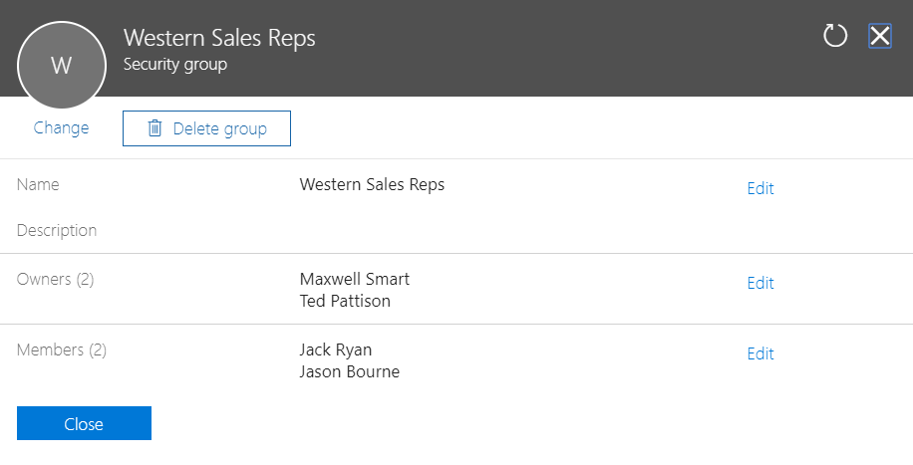
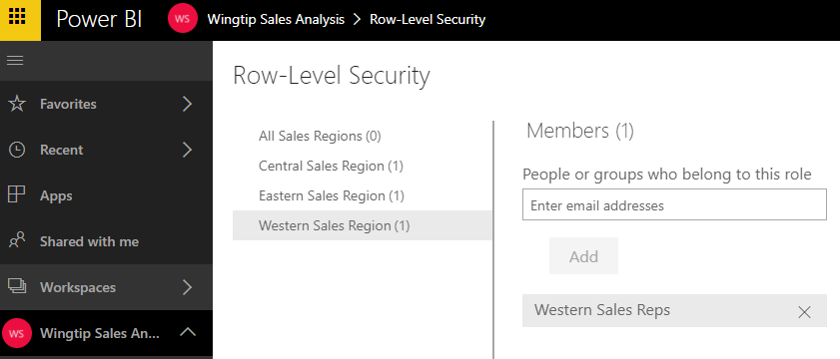
Configuring RLS in the Power BI Service

Slide 35
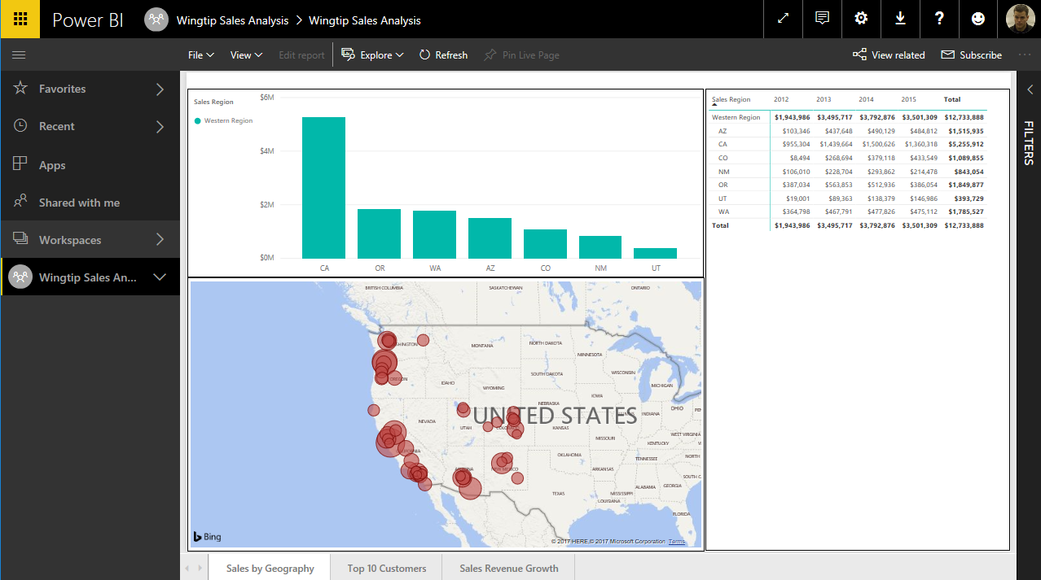
RLS Enforcement

Slide 36
Configuring Row-level Security

Slide 37
Agenda
User Authentication and Identity
Power BI Tenant Administration
Data Security
App Workspaces
Row Level Security
Dynamic Row Level Security

Slide 38
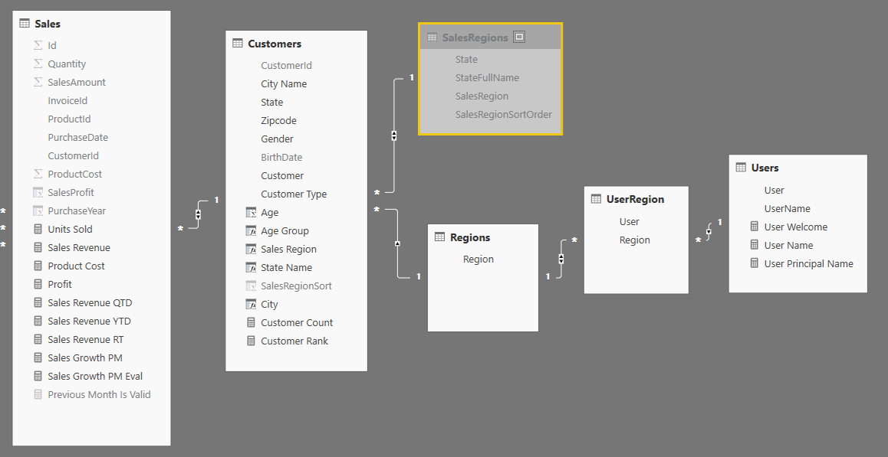
Dynamic RLS
Design pattern for data-driven security
RLS set up to use login name of current user
Permission assignments are included as part of dataset
Implemented using bi-directional cross-filtering

Slide 39
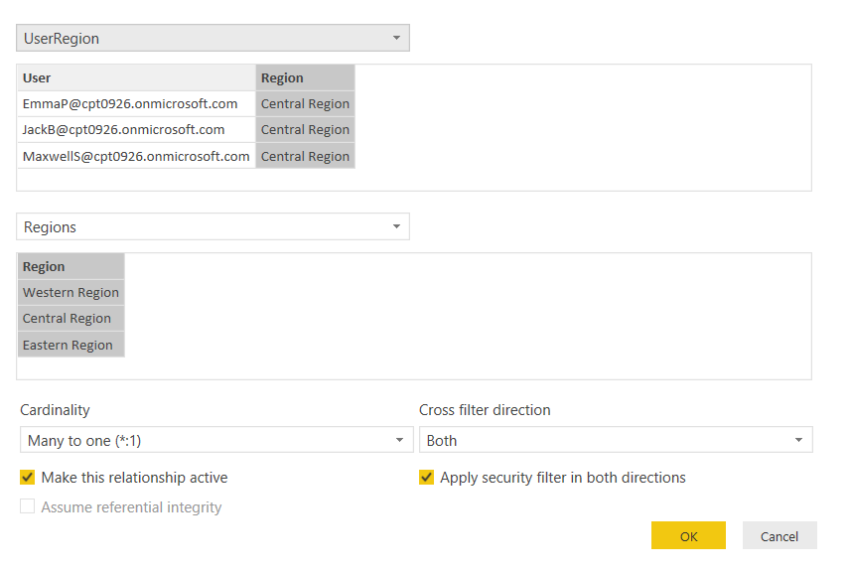
Configuring Cross-direction Filtering

Slide 40
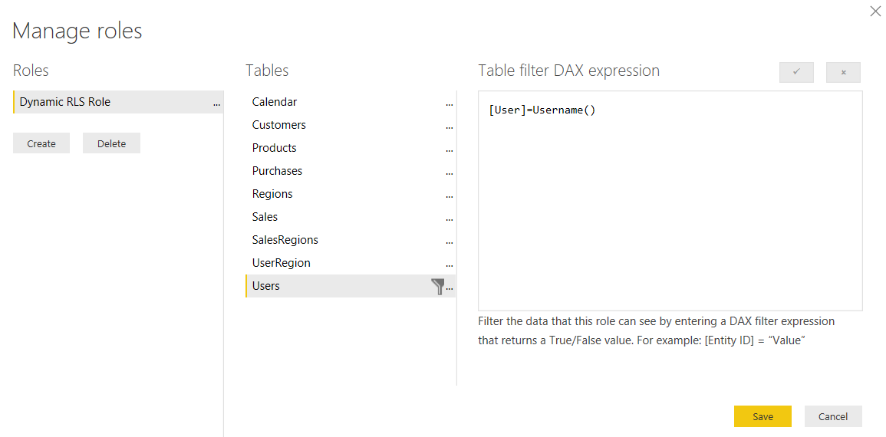
Dynamically Tracking the Current User

Slide 41
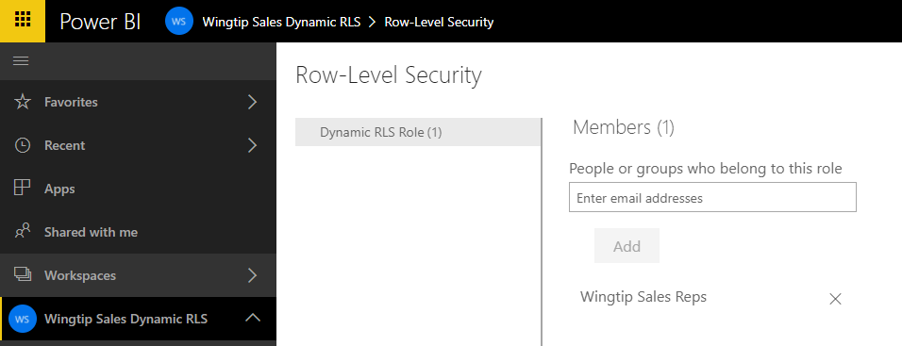
All Users Must Be Added To a Role

Slide 42
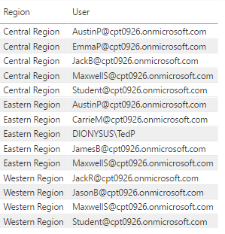
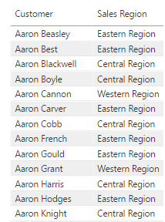
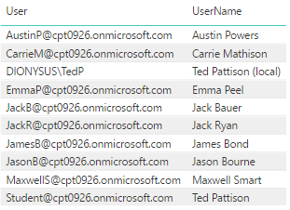

Dynamic RLS Table Filtering
UserRegion
Customers
Users
Users

Slide 43
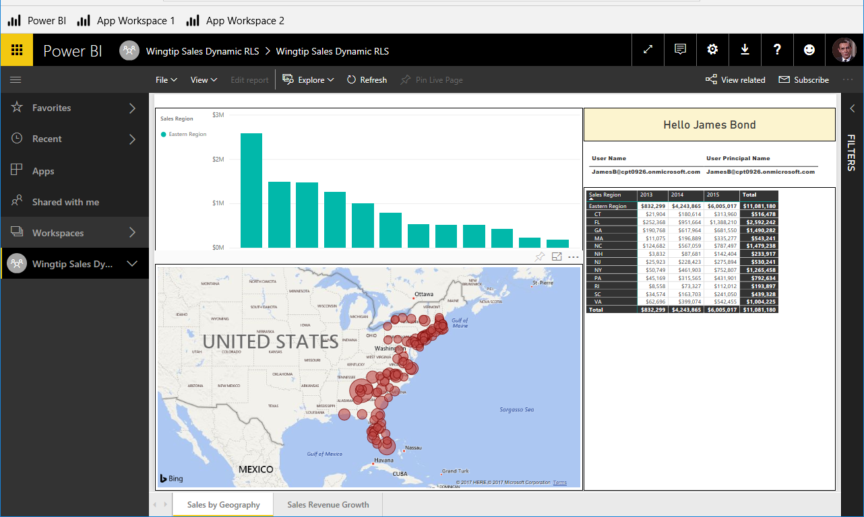
Dynamic RLS Enforcement

Slide 44
Configuring Dynamic Row-level Security

Slide 45
Summary
User Authentication and Identity
Power BI Tenant Administration
Data Security
App Workspaces
Row Level Security
Dynamic Row Level Security

Slide 46

Critical Path Training https://www.CriticalPathTrainig.com
PBI365: Power BI Boot Camp – 4 Days
Audience is Business Users, Analysts and Data Professionals
Provides hands-on introduction to the Power BI platform
Focuses on build solutions using Power BI Desktop
Query design, data modeling and report and dashboard design
Apps and App Workspaces
PBD365: Power BI Developer Boot Camp – 4 Days
Audience is Professional Developers
Teaches developing custom visuals with TypeScript and D3
Teaches programming with the Power BI APIs
Teaches developing with Power BI Embedded
Teaches R programming and integrating R with Power BI
Teaches how to develop custom connector using M

